Slide 1
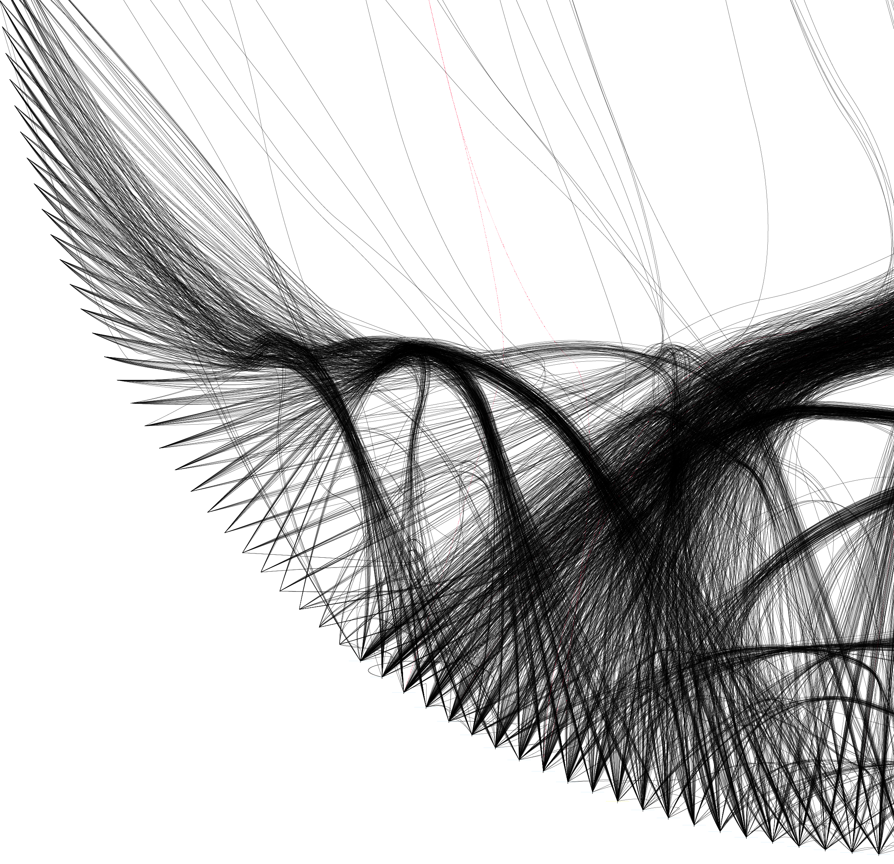

NETWORKS Anders K. Krabberød, University of Oslo

Slide 2
Give a brief introduction to ecological association networks
Results for association networks for a long-term times series
Look at the difference between userach clustering (OTUs) and DADA2 (ASVs) on amplicon data
Results from a soil depth study

Slide 3
Why Networks?
BackGround
Visualise and analyse high-dimensional datasets with complex distribution
Networks are perfect for exploring relational data
Facebook friends
Kevin Bacon game
Erdöz number
Exploration of network topology can give insight into associations and interactions between the parts (nodes) in the network

Slide 4
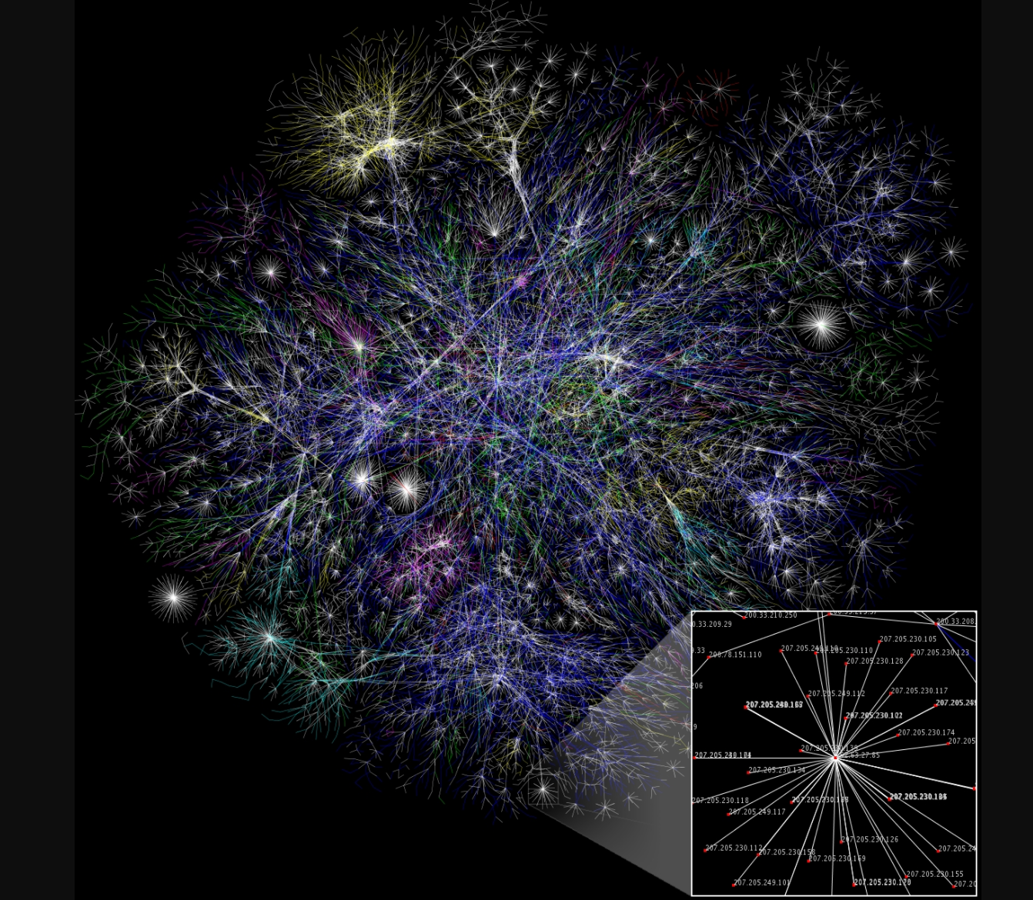
wikimedia

Slide 5
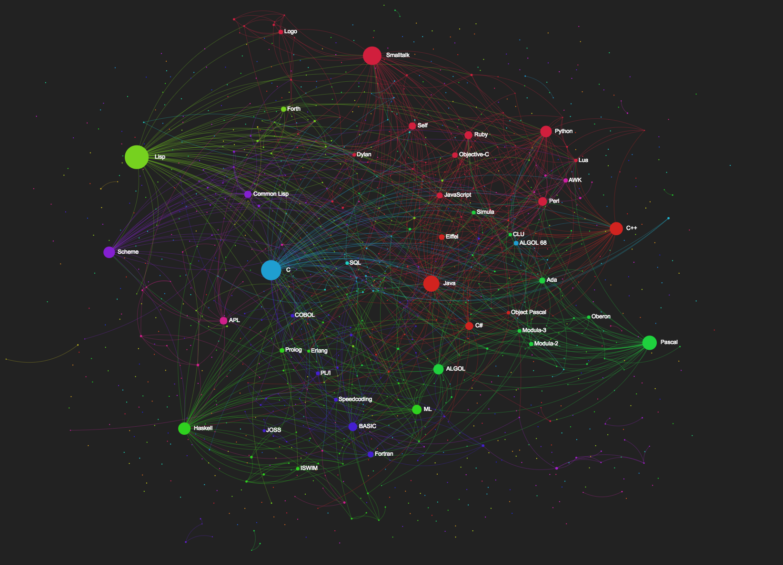

Slide 6
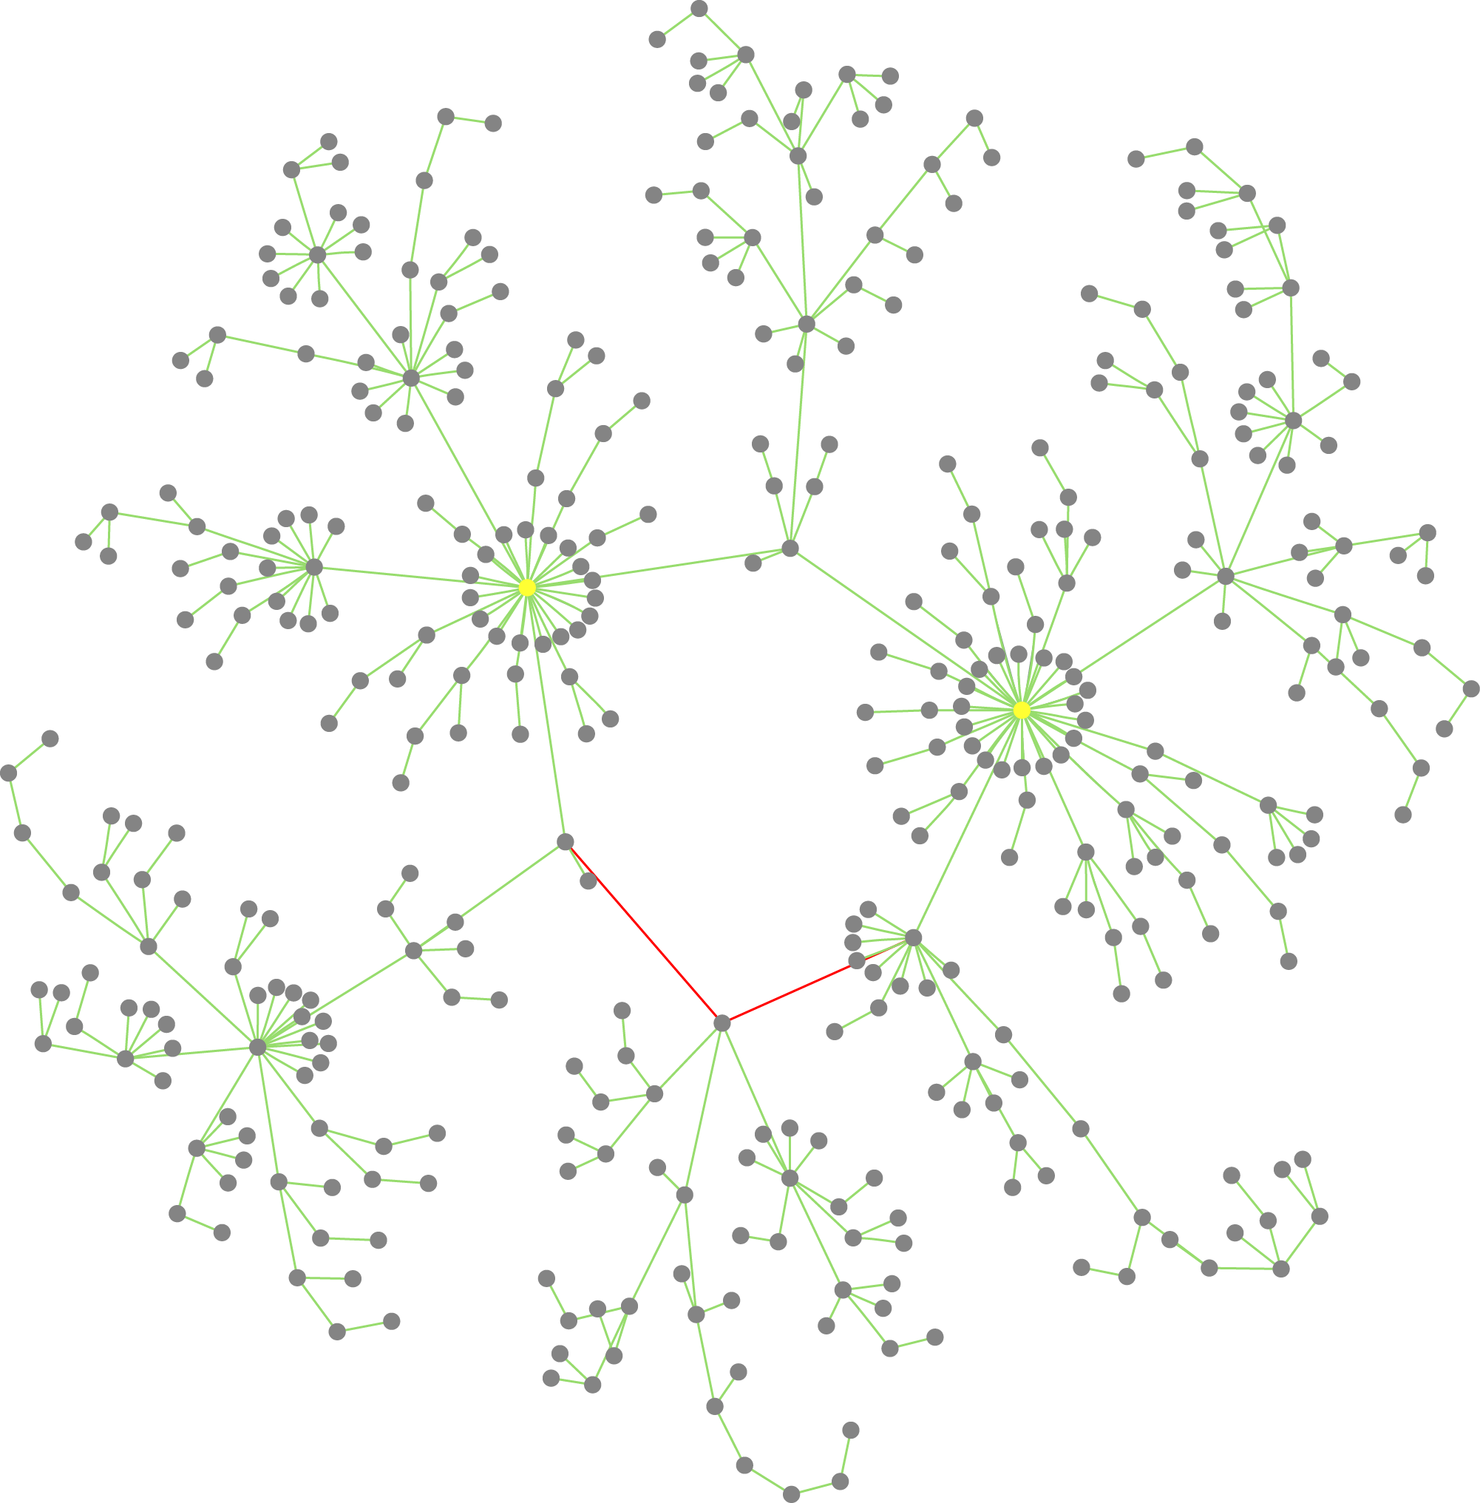
Ecological association networks
Networks can help us find patterns behind small- and large-scale ecological and evolutionary processes
Moving from from identification of parts (species classification, diversity, community composition, geographical distribution etc.) to connections of parts.
Krabberød et al. (2017)

Slide 7
Ecological association networks
Associations/co-occurrence between microbial OTUs/ASVs can reveal:
interactions between organisms, e.g. host/symbiont, prey/predator
similar response to environmental variation
similar niche preference
key species (hubs) and assemblages of interacting species (modules)

Slide 8
Network Features – Some terminology
Networks
Hubs are highly connected nodes, often key species in the network.
Modules: sets of nodes that are more linked to each other than the rest of the network.
Krabberød et al. (2017)

Slide 9
Categories of data for networks
Spatial:
Can cover large geographical areas.
Miss out on seasonal variation and turnover in community composition
Temporal
Smaller geographic coverage, with multiple data points for the same location. Allows following microbial communities, and their changes, in time.
Different scales
Turn-over for microbial communities can be in the span of days or weeks
In addition there are seasonal patterns of community assembly

Slide 10
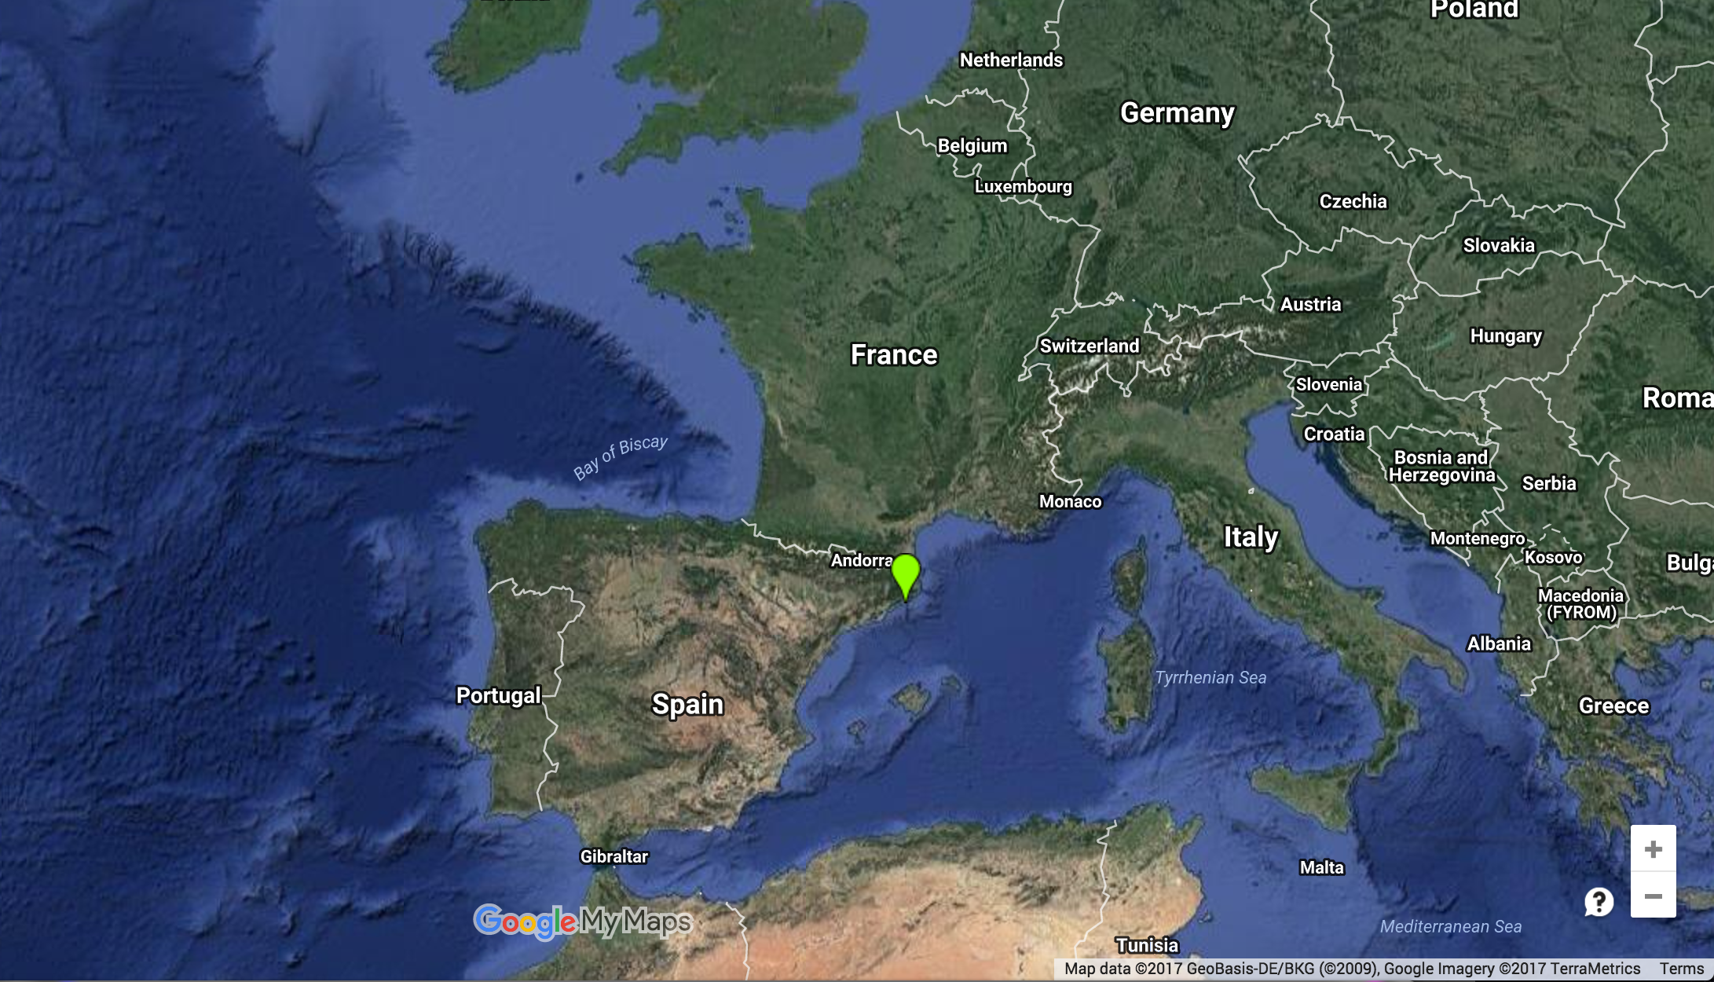


Blanes Bay Marine Observatory
10 years of monthly sampling (120 samples)
DNA from two size fractions
Pico (0.2-3um)
nano (3-20um)
Microbial eukaryotes and bacteria
18 environmental parameters
In collaboration with Ramiro Logares, ICM Barcelona
Ramiro Logares

Slide 11
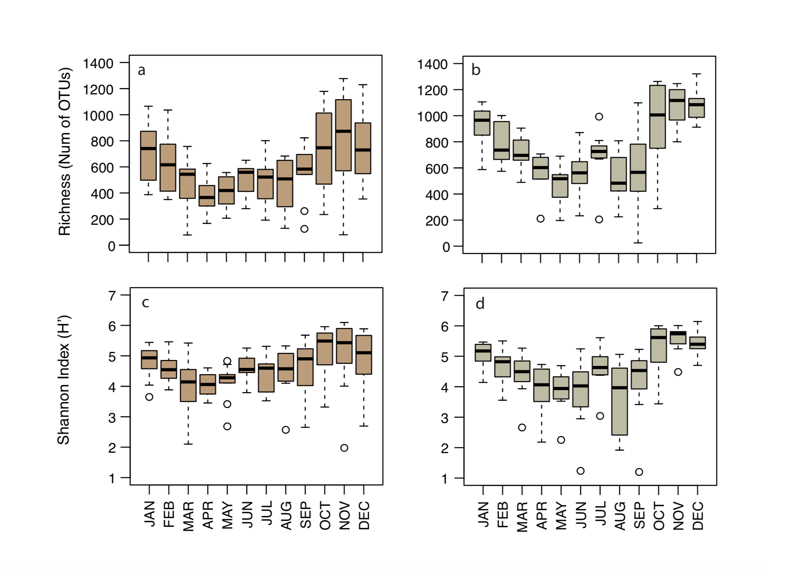
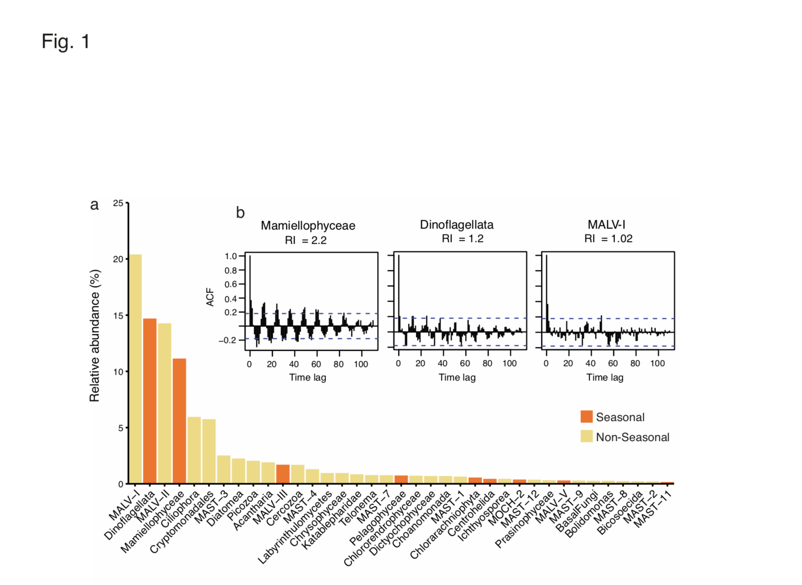
Diversity and seasonality
Giner et al. (2018, Molecular Ecology )
There is a seasonal pattern in the eukaryotic community
Some species (OTUs) show a clear seasonality

Slide 12
Amplicon data
Pico (<3 um) and nano (3-20 um)
Illumina amplicons from 18S (V4) and 16S (V3)
16 Millions sequences total
OTUs vs ASVs
1) clustering based on 99% sequence similarity with userach-> Operational Taxonomic Units (OTU)
2) With DADA2-> Amplicon sequence variants (ASV)

Slide 13
ASV vs. OTU
OTUs
Group sequences based on a predefined similarity value. We used 99% (did the same for bacteria and eukaryotes)
(eg ﻿Edgar et al. 2013)
ASVs
With this method it is possible to correct for sequencing errors, and distinguish sequence variants differing by as little as one nucleotide
(e.g. Callahan et al. ISME 2017)

Slide 14
Microbiome
Total number of OTUs and ASVs
OTUs and ASVs in >10% of the samples after subsampling
“Core Microbiome”; OTUs and ASVs >30% of the samples
 | OTU | ASV
Total OTUs/ASVs | 52 216 | 45 482
Eukaryotes (18S) | 36 020 | 28 876
Prokaryotes (16S) | 16 196 | 16 606
 | OTU | ASV
Total OTUs/ASVs | 5 637 | 2987
Eukaryotes (18S) | 2 825 | 1366
Prokaryotes (16S) | 2 812 | 1621
 | OTU | ASV
Total OTUs/ASVs | 1 953 | 744
Eukaryotes (18S) | 888 | 356
Prokaryotes (16S) | 1 067 | 388

Slide 15
Relative abundance of the Core Microbiome
OTUs
ASVs
Bacteria
Eukaryotes

Slide 16
Relative abundance of the Core Microbiome
OTUs
ASVs
Bacteria
Eukaryotes
Dinoflagellates
Eukaryotes
Syndiniales

Slide 17
Relative abundance of the Core Microbiome
OTUs
ASVs
Bacteria
Eukaryotes
Dinoflagellates
Eukaryotes
Syndiniales
SAR11
Bacteria
Cyanos

Slide 18
OTU vs ASV
High number of OTUs compared to ASV for very abundant groups
SAR11:
284 OTUs
42 ASVs
ASVs
OTUS

Slide 19
OTU vs ASV
High number of OTUs compared to ASV for very abundant groups
SAR11:
284 OTUs
42 ASVs
ASVs
OTUS
Syndiniales
Synechococcus
Two genera of Dinoflagellates: Gyrodinium and Karlodinium

Slide 20
Relative abundance.
Core microbiome (in more than 30% of the samples)
Relative abundance of top 20 Genera

Slide 21
Similartity analysis
Networks
ELSA – Extended Local Similarity Analysis
Ruan et al (2006) ;Xia et al (2011)
Designed for time series
Can incorporate time delays (the maximum allowed time delay has to be specified)
Multiple co-occurrences and co-exclusions in the same community

Slide 22
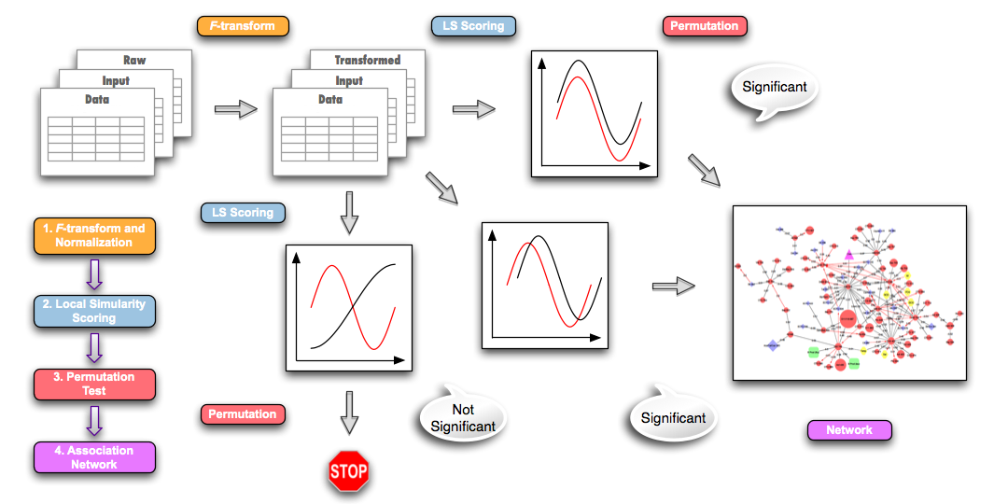
Local Similarity Analysis
Networks
Positive Similarity
Notes:
Data are transformed, and values for missing data are calculated
Pairwise comparison between all OTUs (and OTUs and environmental data)
Designed to pick up complex dependencies between data not necessarily detected by correlation analysis.

Slide 23
Local Similarity Analysis
Networks
Ruan et. al 2006, Xia et al. 2011, 2013
Negative Similarity
Notes:
Data are transformed, and values for missing data are calculated
Pairwise comparison between all OTUs (and OTUs and environmental data)
Designed to pick up complex dependencies between data not necessarily detected by correlation analysis.

Slide 24
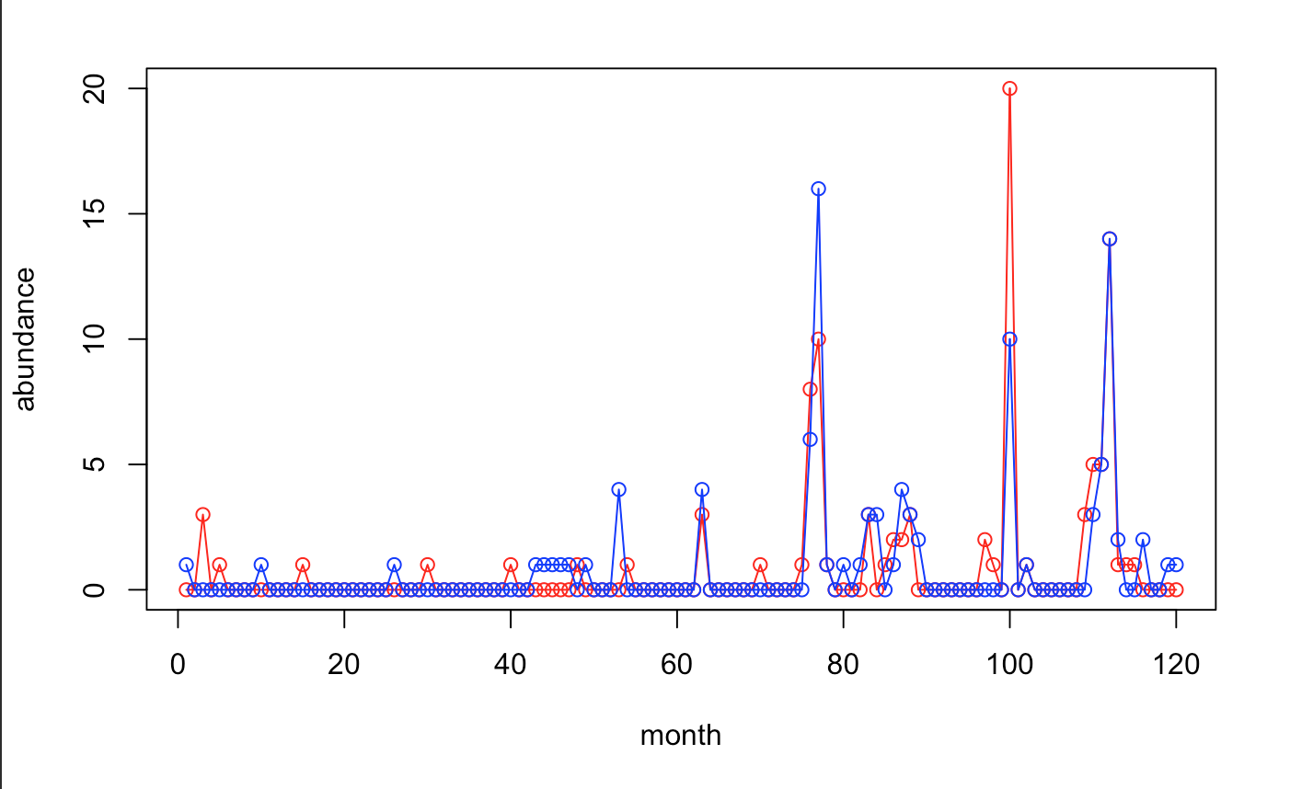
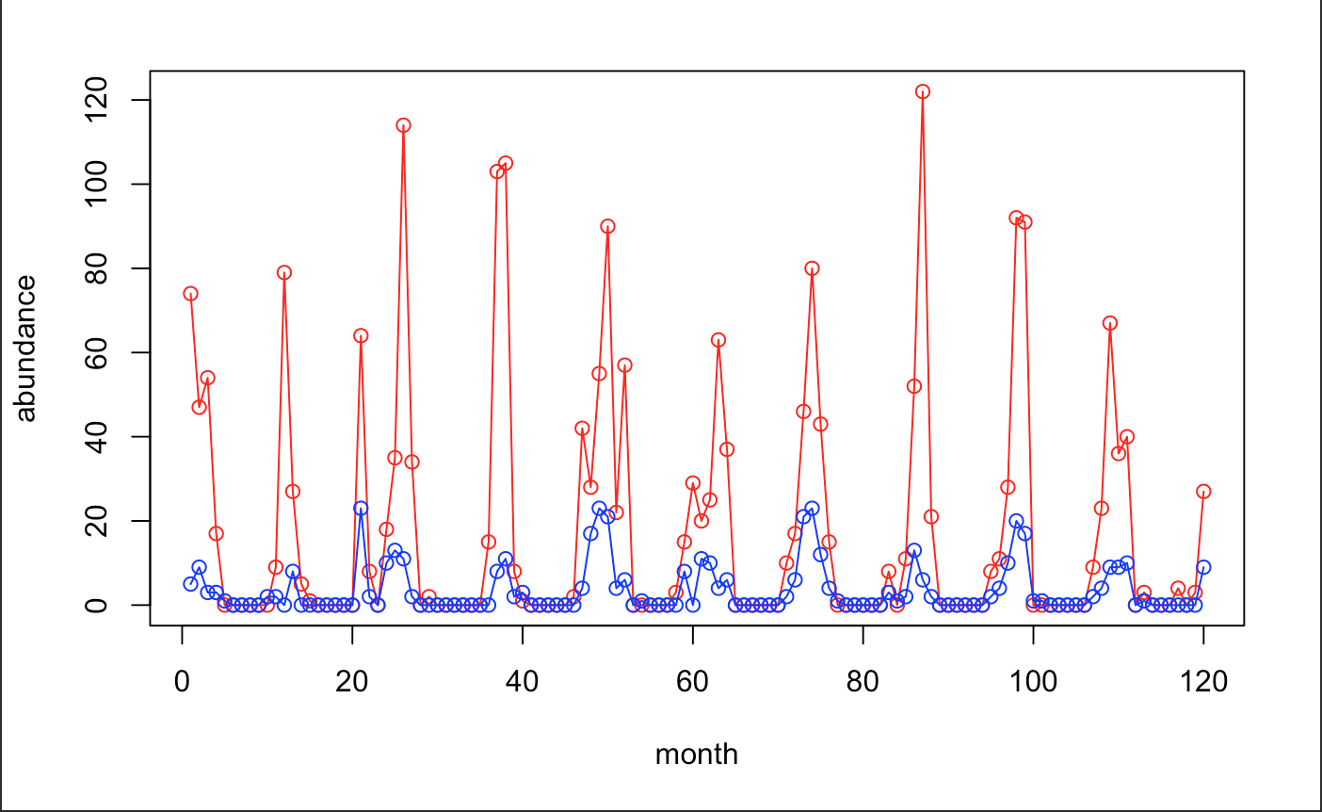
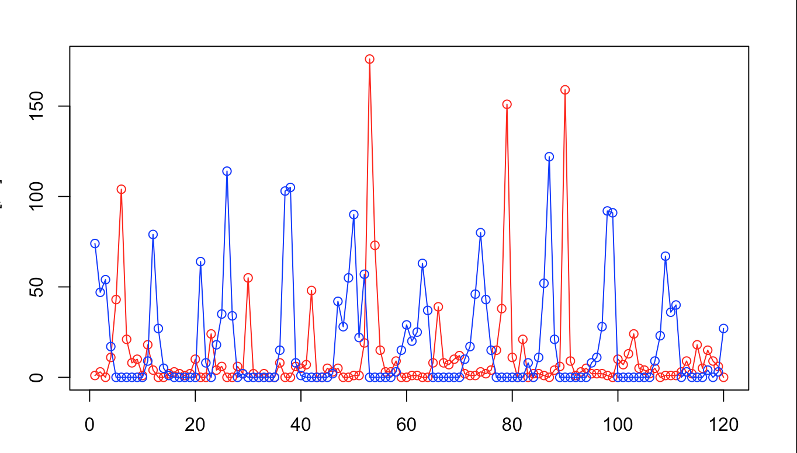
Local Similarity Analysis
Networks
Ruan et. al 2006, Xia et al. 2011, 2013
Local similarity
Notes:
Data are transformed, and values for missing data are calculated
Pairwise comparison between all OTUs (and OTUs and environmental data)
Designed to pick up complex dependencies between data not necessarily detected by correlation analysis.

Slide 25
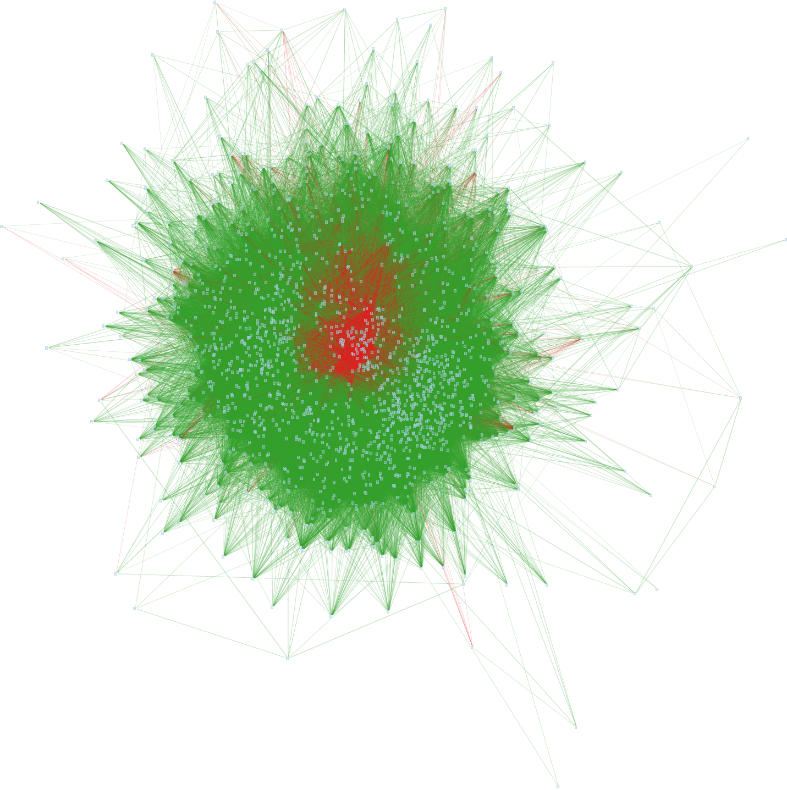
Networks
1955 OTUs and 15 environmental parameters
After removing non-significant edges (P&Q<0.05)
90566 associations (edges)
86540 positive (95.5%) and
4026 negative (4.5%)
Green edges are positive, red negative co-occurrence. White nodes are eukaryotes, blue are bacteria and green environmental variables

Slide 26
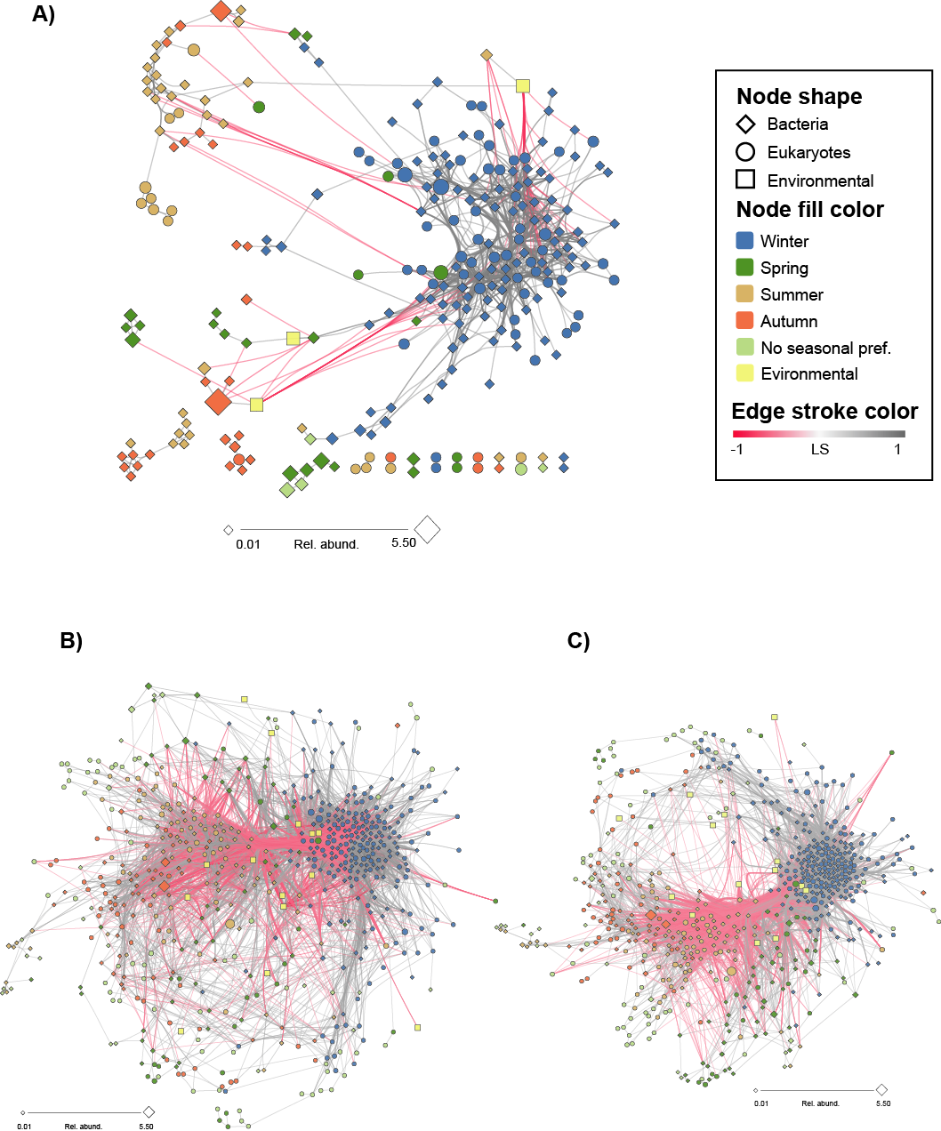
Networks
1955 OTUs and 15 environmental parameters
After removing non-significant edges (P&Q<0.05)
90566 associations (edges)
86540 positive (95.5%) and
4026 negative (4.5%)
795 ASVs and 14 environmental parameters
After removing non-significant edges (P&Q<0.05)
36631 associations (edges)
29663 positive (81%) and
6968 negative (19%)
Green edges are positive, red negative co-occurrence. White nodes are eukaryotes, blue are bacteria and green environmental variables

Slide 27
Networks
795 ASVs and 14 environmental parameters
After removing non-significant edges (P&Q<0.05)
36631 associations (edges)
29663 positive (81%) and
6968 negative (19%)
Then we increased the cut-off for local similarity and Spearman correlation to >0.7 to look at the strongest association.
We also chose to analyze the “Core Microbiome”, species in more >30% of the samples.

Slide 28
Core Interactome
Networks
There are more bacteria species (67.9%) than eukaryotic speices
Almost all associations are positive (95.1 %)
One part is highly interconnected These are ASV that are more common during the winter season (as calculated by IndVal).

Slide 29
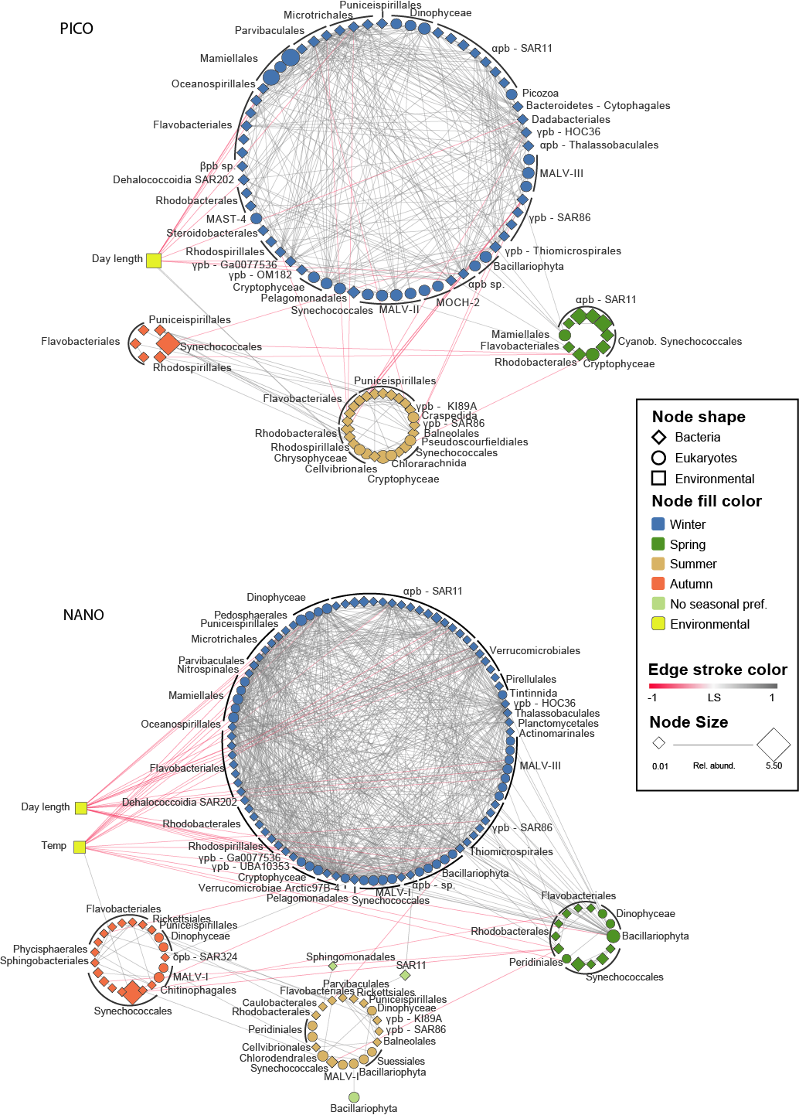
Seasonality
Winter community has the highest proportion of taxa (ASVs) in both size fractions
Winter/spring communities has a higher number of association and are tighter knit (clustering coefficient 0.452), than summer/autumn (cc 0.305)
There is overlapping associations between winter and summer communities.
Summer and autumn are much looser structured

Slide 30
Interactions?
Some of the associations (edges) are due to two organisms reacting to the same environmental variable.
What about direct biotic interactions (symbiosis, parasitism, predation) ?

Slide 31
Validation
Networks
Correlation does not imply causation
Need tools to validate associations as interaction
We have built database of protist interactions

Slide 32


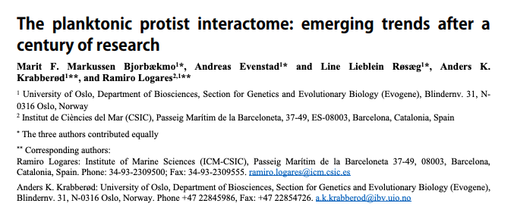
PIDA – Protist interaction database
Networks
We have assembled a database based on known interactions from existing literature and integrated it with other databases
PIDA: Protist interaction database
Github: https://github.com/ramalok/PIDA
﻿The ISME (2019) doi.org/10.1038/s41396-019-0542-5
over 2500 entries from 537 publications
ca 700 species of host and predators
ca 400 species of symbionts and prey
Andreas Evenstad
Marit Bjorbækmo
Line Røsæg
Ramiro Logares

Slide 33
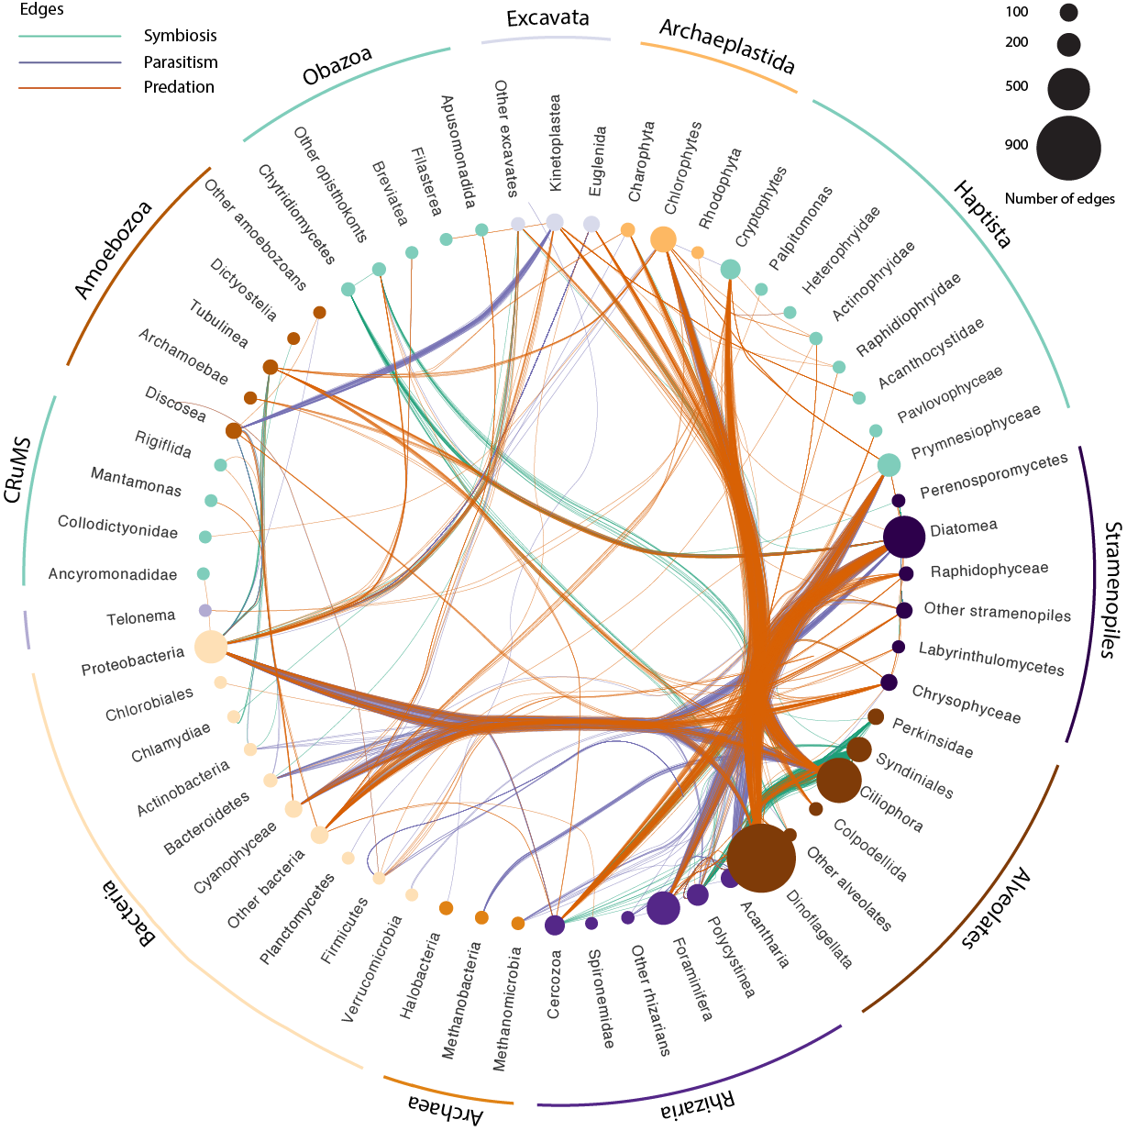
PIDA - summary
Networks
Size of the nodes are proportional to the number of registered interactions.
Diatoms, dinoflagellates, and ciliates have the highest numbers of entries in the database.
Annotate the network from Blanes Bay with interaction information from PIDA
But, there were few matches…

Slide 34
Acknowledgments
@University of Oslo:
Marit Bjorbækmo
Line Røsæg
Russell Orr
Andreas Evenstad
@ ICM CSIC:
Ramiro Logares
Ina M. Deutschmann
Caterina R. Giner
Fran Latorre
Lidia Montiel
Ramon Massana

Slide 35
Soil Depth Study
Networks
Sunil Mundra, Håvard Kauserud et al.
Purpose:
Investigate protist, fungus and bacteria at different depths in soil
Soil depth represents a strong physiochemical gradient that greatly affects
Test whether depth-dependent variation in soil chemistry affects the distribution and co-occurrence patterns of microbial communities.

Slide 36
Soil Depth Study
Networks
Four depths at 60 sites
Illumina data from three markers
16S V9 for bacteria
18 V4 for eukaryotes
ITS2 for fungi
Vsearch, 97% for 16S and ITS, 98% for 18S
1540 bacterial OTUs
4388 fungal (3461 ITS-based; 927 18S-based)
2025 micro-eukaryotic

Slide 37
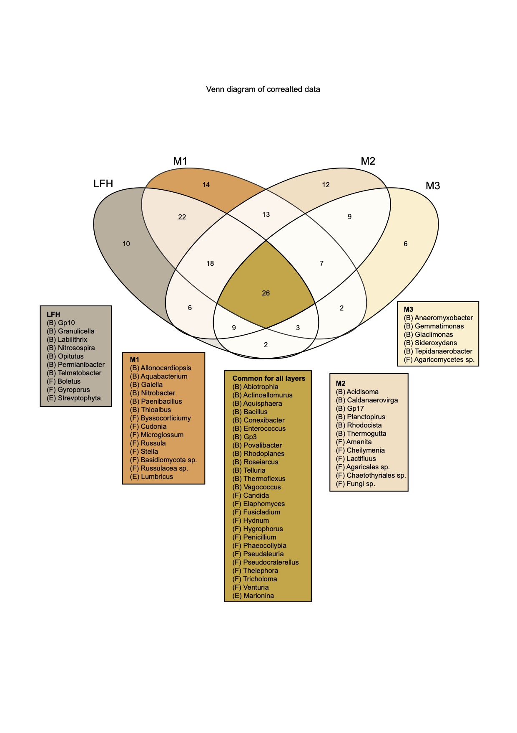
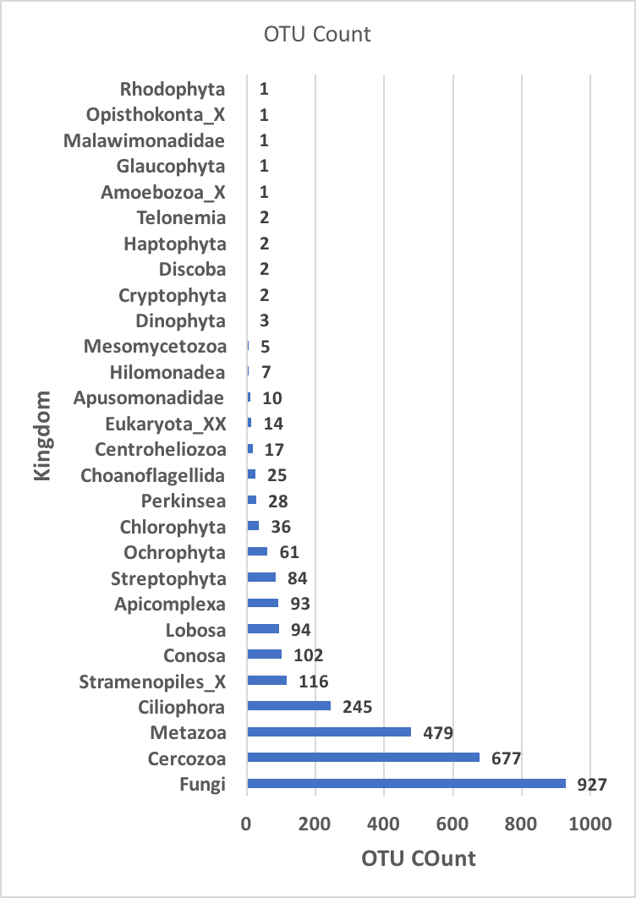
Soil Depth Study
Networks

Slide 38
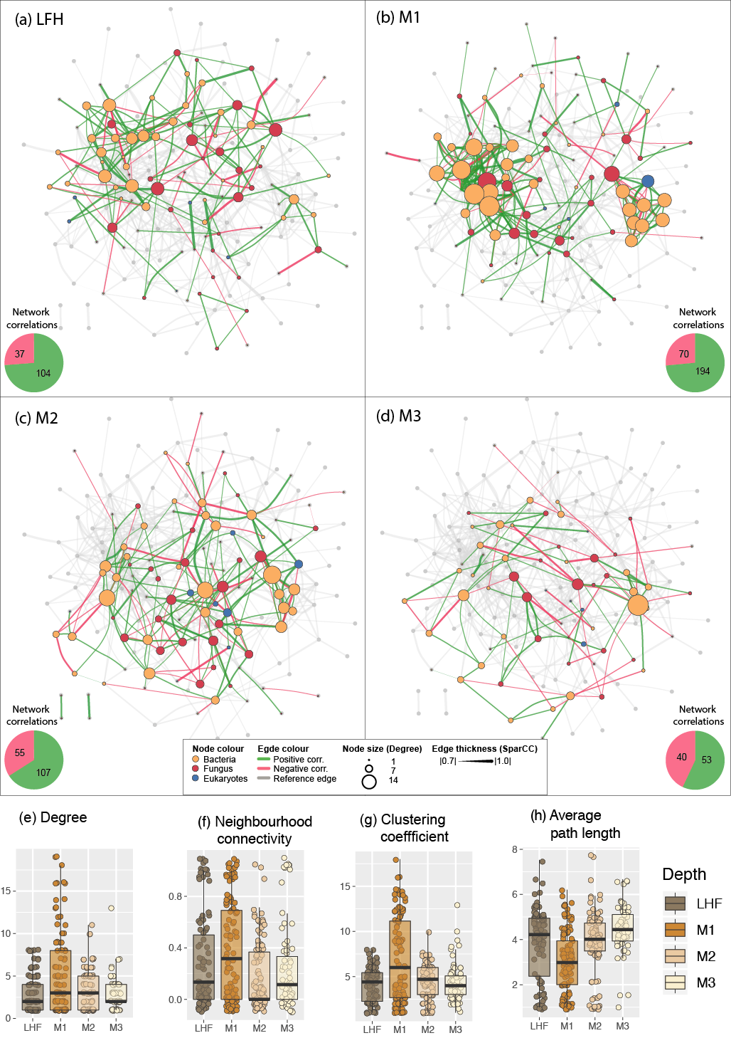
Soil Depth Study
Networks
SparCC networks for each of the four depths.
The network has highest density for the M1 depth (i.e. the first mineral layer)
In the deepest level the proportion of negative occurrences was highest

Slide 39
Soil Depth Study
Networks
SparCC networks for each of the four depths.
The network has highest density for the M1 depth (i.e. the first mineral layer)
In the deepest level the proportion of negative occurrences was highest

Slide 40
Soil Depth Study
Networks
SparCC networks for each of the four depths.
The network has highest density for the M1 depth (i.e. the first mineral layer)
In the deepest level the proportion of negative occurrences was highest

Slide 41
SparCC
Networks
A network algorithm for inferring correlation in sparsely composed data
﻿SparCC (Friedman and Alm, 2012) infers correlations among otus by utilizing log-ratio transformation to eliminate the effect of the total number of read counts, while imposing sparsity of correlations among otu.
Exercise: use the R script for making SparrCC networks on github.

Slide 42
Some Resource
SparCC: a python module for computing correlations in compositional data (16S, metagenomics, etc'). https://bitbucket.org/yonatanf/sparcc
iGraph package for R:
https://www.r-bloggers.com/an-example-of-social-network-analysis-with-r-using-package-igraph/
The code repository for Schmidt et. al 2017 “A Family of Interaction-Adjusted Indices of Community Similarity” doi:10.1038/ismej.2016.139
https://github.com/defleury/Schmidt_et_al_2016_community_similarity/
eLSA: https://bitbucket.org/charade/elsa/wiki/Home
fast eLSA: http://www.cmde.science.ubc.ca/hallam/fastLSA/
Tutorial for WGCNA: https://labs.genetics.ucla.edu/horvath/CoexpressionNetwork/Rpackages/WGCNA/Tutorials/index.html

